Slide 1

Projektovanie sietí 2
Branislav Juriš
Peter Hadač
Marek Buček
Samuel Kurnas

Slide 2

Nové riešenie
Zníženie počtu ring smerovačov
Zachovanie redundantných spojov
Huawei platforma

Slide 3
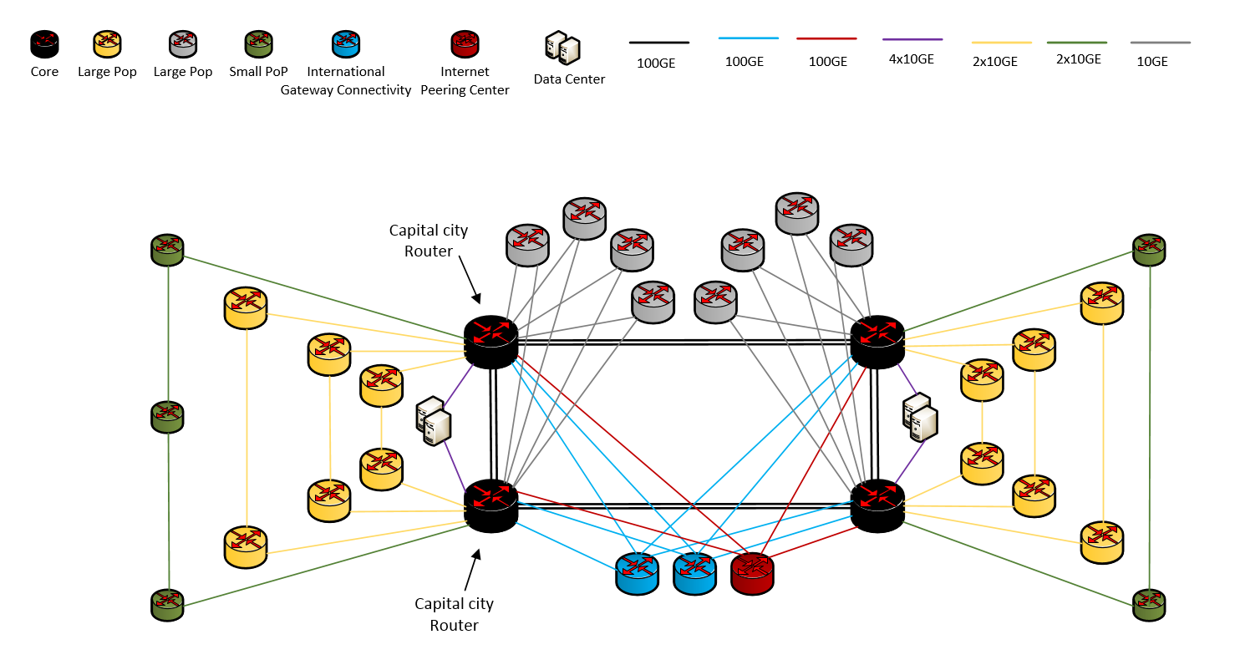
Naše riešenie

Slide 4
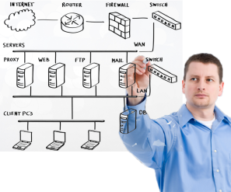
Výhody nášho riešenia
zvýšenie spoľahlivosti
zrýchlenie
zjednodušenie
ušetrenie výdavkov za výkopové práce
zníženie nákladov na školenia
kompatibilita

Slide 5
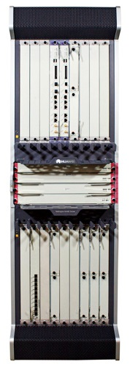
Chrbtica Chassis - NetEngine5000E-X16A 480G
Vlastnosti | Požiadavka | Nové zariadenie
Minimálna agregovaná priepustnosť na zariadenie | 16 Tbps | 25 Tbps
Minimálna prenosová kapacita na rozhranie (full duplex) | 400 Gbps | 819 Gbps
Požiavky na porty | 8x 100GE 16x 10GE 40x GE (optical) | 8x 100GE 20x 10GE 48x GE (optical)
Redundantný procesor | Yes | Yes
Redundantný switching fabric | Yes | Yes
Redundantné napájanie | Yes | Yes

Slide 6
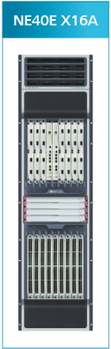
Veľký POP CHASSIS- NE40E-X16A (480G)
Vlastnosti | Požiadavka | Nové zariadenie
Minimálna agregovaná priepustnosť na zariadenie | 8 Tbps | 12.58 Tbps
Minimálna prenosová kapacita na rozhranie (full duplex) | 200 Gbps | 480 Gbps
Požiavky na porty | 24x 10GE 80x GE (optical) 20x GE (RJ-45) | 48x 10GE 80x GE (optical) 40x GE (RJ-45)
Redundantný procesor | Yes | Yes
Redundantný switching fabric | Yes | Yes
Redundantné napájanie | Yes | Yes

Slide 7
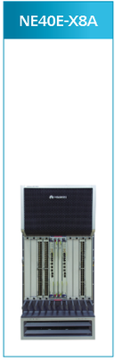
Malý POP CHASSIS - NE40E-X8A (480G)
Vlastnosti | Požiadavka | Nové zariadenie
Minimálna agregovaná priepustnosť na zariadenie | 1 Tbps | 7.08 Tbps
Minimálna prenosová kapacita na rozhranie (full duplex) | 100 Gbps | 480 Gbps
Požiavky na porty | 16x 10GE 40x GE (optical) 20x GE (RJ-45) | 24x 10GE 40x GE (optical) 40x GE (RJ-45)
Redundantný procesor | Yes | Yes
Redundantný switching fabric | Yes | Yes
Redundantné napájanie | Yes | Yes

Slide 8
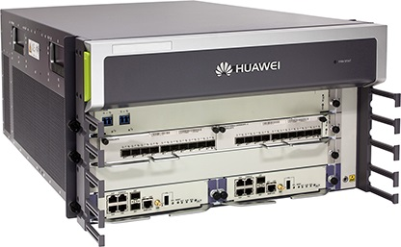
Veľký smerovač CHASSIS - NE40E-X3A (200G)
Vlastnosti | Požiadavka | Nové zariadenie
Minimálna prenosová kapacita na rozhranie (full duplex) | 80 Gbps | 200 Gbps
Požiavky na porty | 2 x 10GE 24 x1GE (optical) 8 x GE/FE RJ-45 4 x STM1 (optical) 8 x E1 | 40x GE (optical) 40x GE (RJ-45) 4 x STM1 (optical)
Redundantný procesor | Yes | Yes
Redundantný switching fabric | Yes | Yes
Redundantné napájanie | Yes | Yes

Slide 9
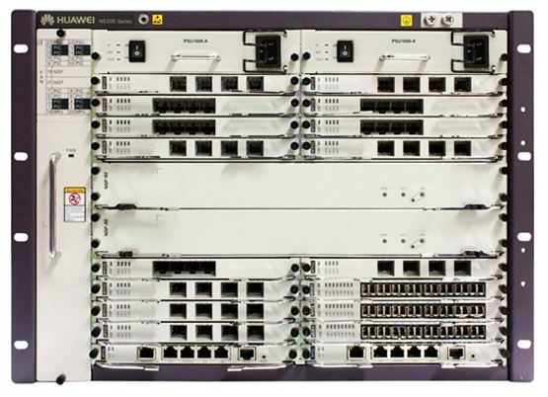
Malý smerovač CHASSIS - NE20E-S16 (100G)
Vlastnosti | Požiadavka | Nové zariadenie
Minimálna prenosová kapacita na rozhranie (full duplex) | 40 Gbps | 100 Gbps
Požiavky na porty | 16 x 1GE (optical) 8 x GE/FE RJ-45 8 x E1 dobrovoľne | 20x 1GE (optical) 8x GE (RJ-45)
Redundantný procesor | Yes | Yes
Redundantný switching fabric | Yes | Yes
Redundantné napájanie | Yes | Yes

Slide 10
IGW a SIX CHASSIS - NE40E-X8A (480G)
Vlastnosti | Požiadavka | Nové zariadenie
Minimálna agregovaná priepustnosť na zariadenie | 1 Tbps | 7.08 Tbps
Minimálna prenosová kapacita na rozhranie (full duplex) | 100 Gbps | 480 Gbps
Požiavky na porty | 4x 100GE | 4x 100GE
Redundantný procesor | Yes | Yes
Redundantný switching fabric | Yes | Yes
Redundantné napájanie | Yes | Yes

Slide 11
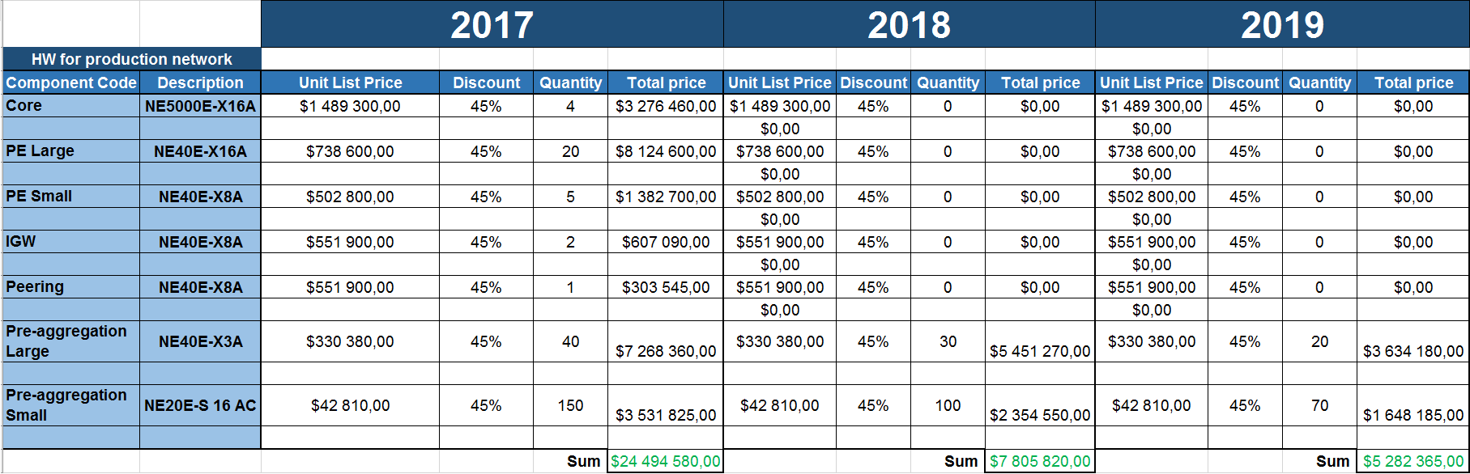
Ceny zariadení

Slide 12
Ceny služieb 2017
Installation, commissioning and Integration
Services | Unit List Price | Discount | Quantity | Total price
Installation & Comm Production network | $216 400,00 | 45% | 1 | $119 020,00
Installation & Comm Lab | $0,00 | 45% | 1 | $0,00
Site Surveys | $12 900,00 | 45% | 1 | $7 095,00
Integration (Configuration, migration, functionality verification) - Production network | $330 600,00 | 45% | 1 | $181 830,00
Logistics | $14 700,00 | 45% | 1 | $8 085,00
Low Level Design | $10 000,00 | 45% | 1 | $5 500,00
 |  |  | Sum | $321 530
Maintenance services | Description | Unit List Price | Discount | Quantity | Total price
Integrator's Annual fees | yearly price | $628 500,00 | 45% | 1 | $345 675,00
3rd party support (TAC support and faulty HW replacement) | yearly price | $639 080,00 | 45% | 1 | $351 494,00
 |  |  |  | Sum | $697 169

Slide 13
Ceny služieb 2018
Installation, commissioning and Integration
Services | Unit List Price | Discount | Quantity | Total price
Installation & Comm Production network | $107 000,00 | 45% | 1 | $58 850,00
Installation & Comm Lab | $0,00 | 45% | 1 | $0,00
Site Surveys | $6 500,00 | 45% | 1 | $3 575,00
Integration (Configuration, migration, functionality verification) - Production network | $188 000,00 | 45% | 1 | $103 400,00
Logistics | $6 500,00 | 45% | 1 | $3 575,00
Low Level Design | $0,00 | 45% | 1 | $0,00
 |  |  | Sum | $169 400
Maintenance services | Unit List Price | Discount | Quantity | Total price
Integrator's Annual fees | $908 500,00 | 44% | 1 | $508 760,00
3rd party support (TAC support and faulty HW replacement) | $923 860,00 | 44% | 1 | $517 361,60
 |  |  | Sum | $1 026 122

Slide 14
Ceny služieb 2019
Installation, commissioning and Integration
Services | Unit List Price | Discount | Quantity | Total price
Installation & Comm Production network | $74 000,00 | 45% | 1 | $40 700,00
Installation & Comm Lab | $0,00 | 45% | 1 | $0,00
Site Surveys | $4 500,00 | 45% | 1 | $2 475,00
Integration (Configuration, migration, functionality verification) - Production network | $130 000,00 | 45% | 1 | $71 500,00
Logistics | $4 500,00 | 45% | 1 | $2 475,00
Low Level Design | $0,00 | 45% | 1 | $0,00
 |  |  | Sum | $117 150
Maintenance services | Unit List Price | Discount | Quantity | Total price
Integrator's Annual fees | $1 101 000,00 | 44% | 1 | $616 560,00
3rd party support (TAC support and faulty HW replacement) | $1 119 880,00 | 44% | 1 | $627 132,80
 |  |  | Sum | $1 243 693

Slide 15
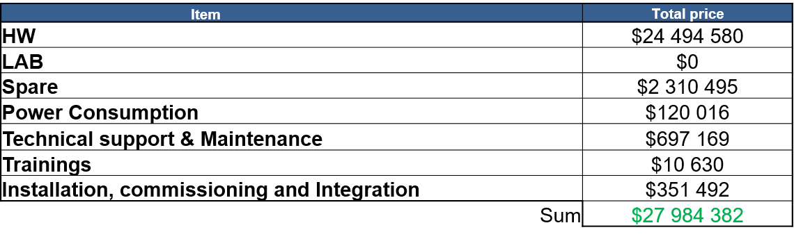
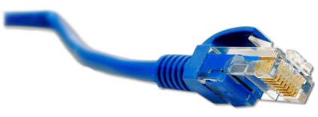
Celková cena 2017

Slide 16
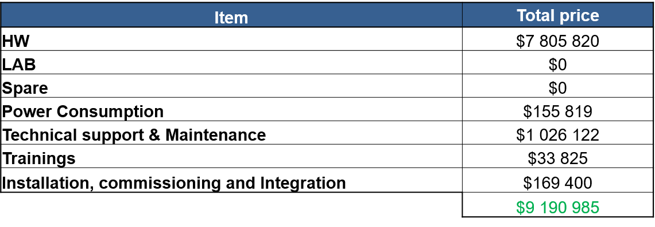
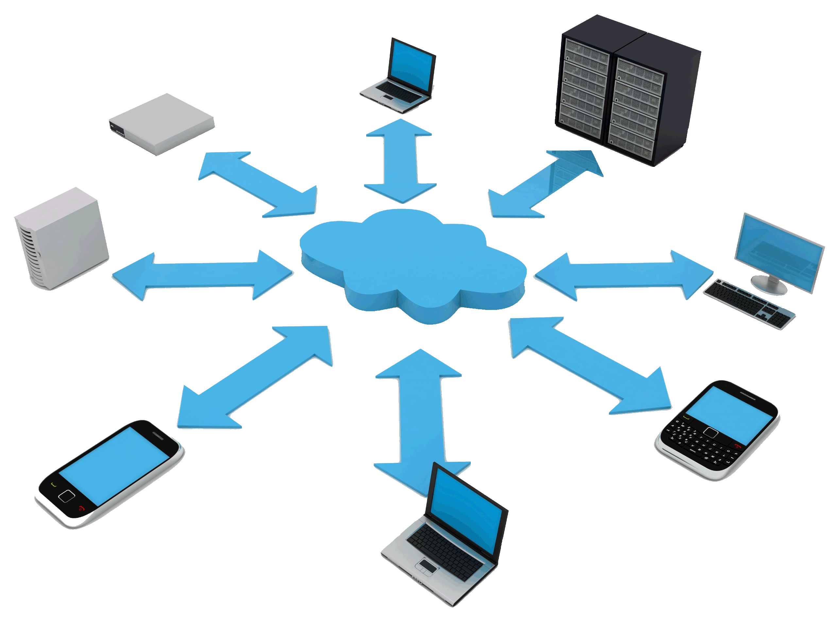
Celková cena 2018

Slide 17
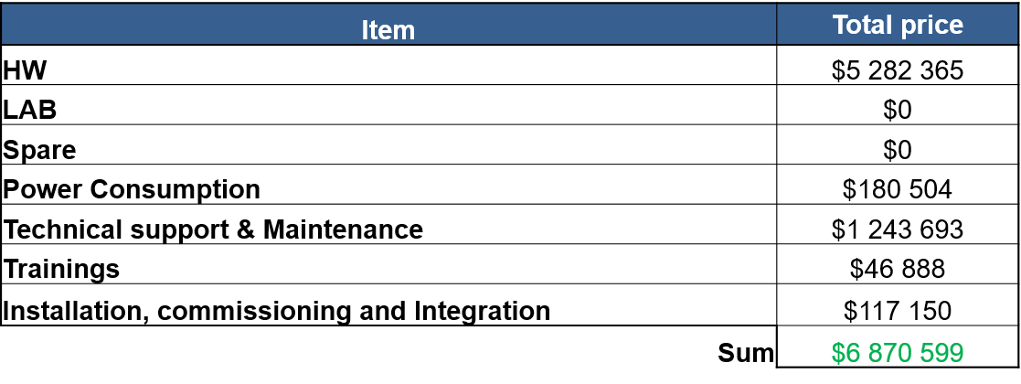

Celková cena 2019

Slide 18

44 045 966,00 $
Celková platba

Slide 19

Ďakujeme za pozornosť !
Branislav Juriš
Peter Hadač
Marek Buček
Samuel Kurnas

